Slide 1
JOSE MENDOZA

Slide 2
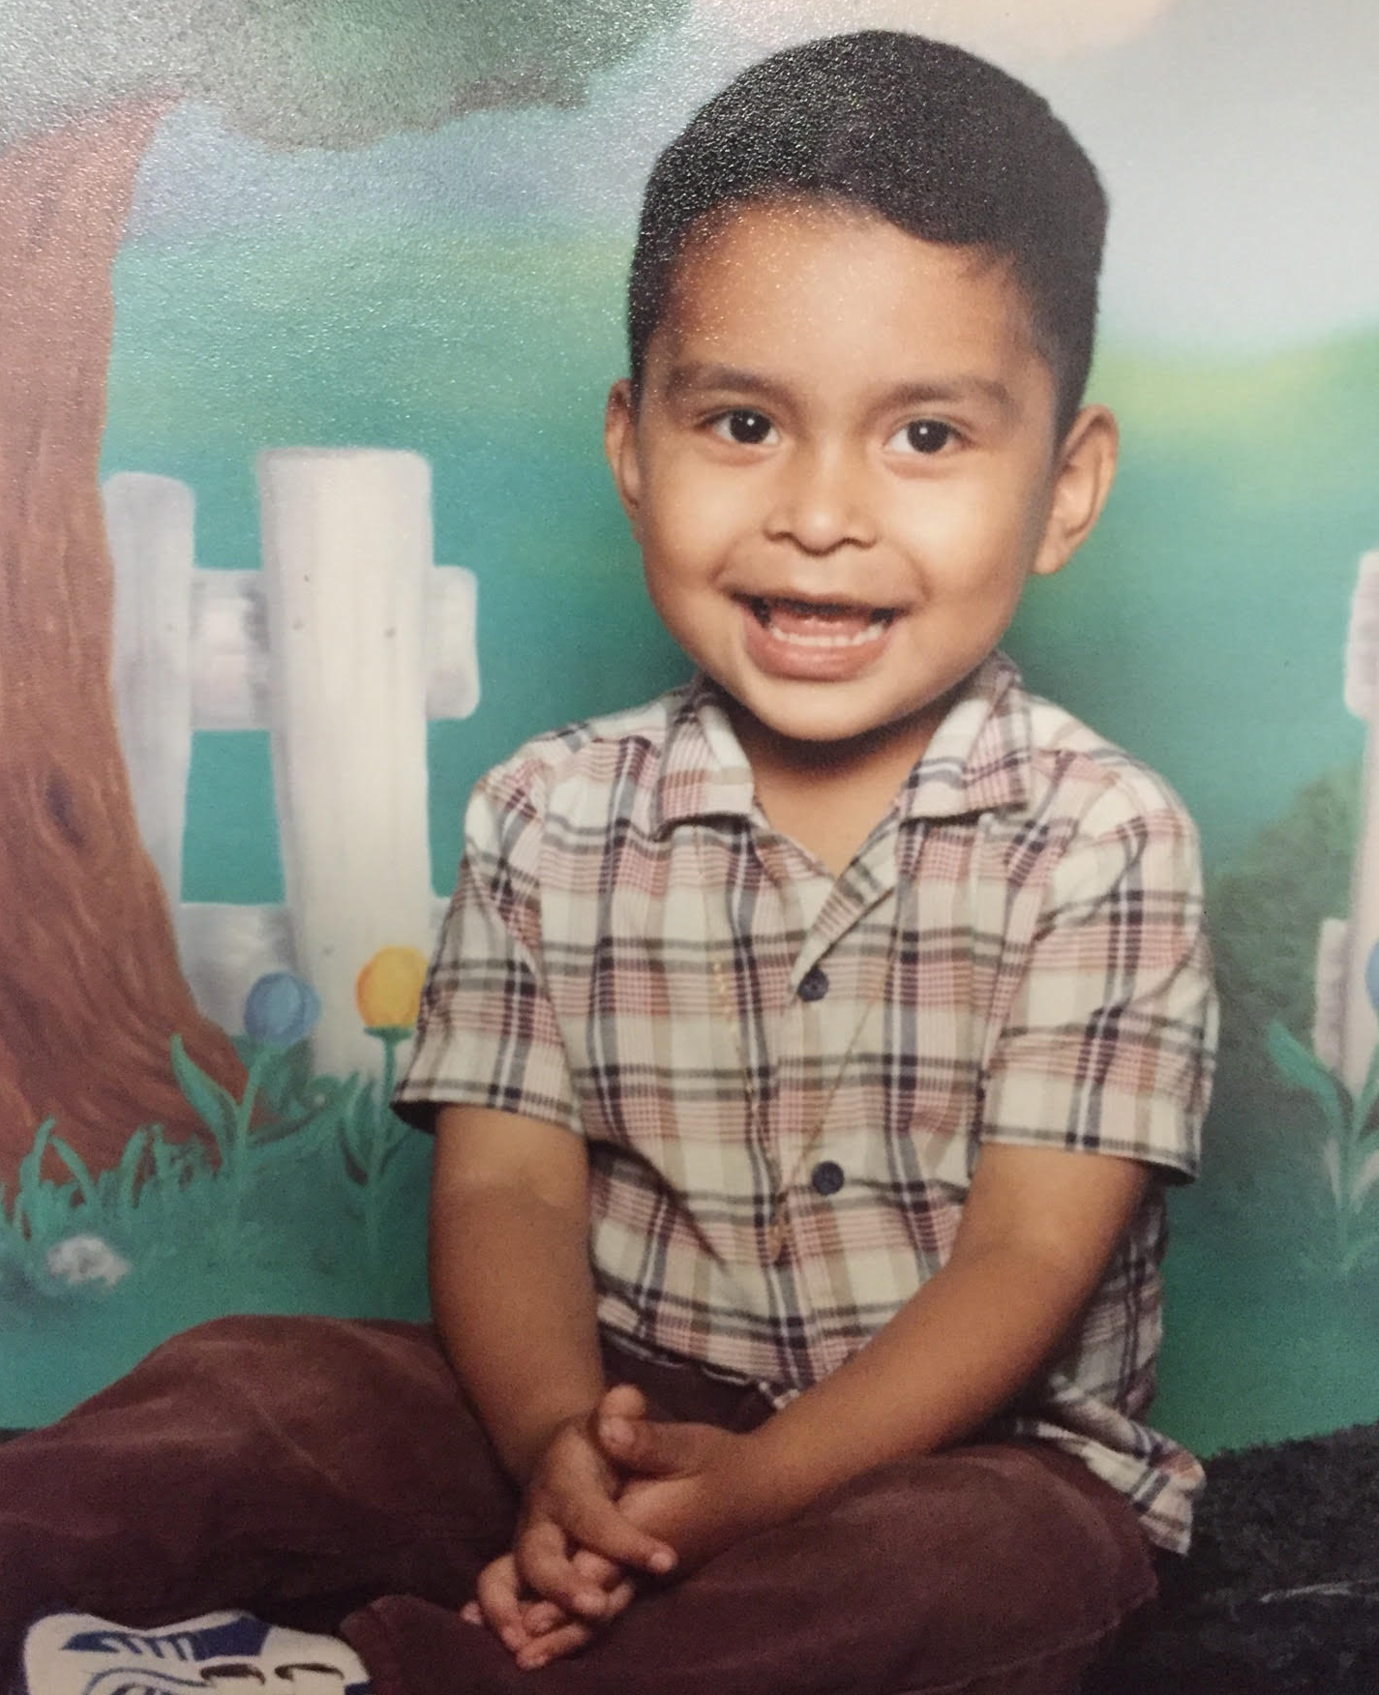
About Me
Born and raised in Lindsay, California
The youngest in my family
17 years old
Enjoy art

Slide 3
High School Experience
Clubs – Red Zone & REAP
Success
Getting ahead in classes
Move at your own pace
Retake test
Challenges
Doing Homework online without internet
Teachers focus on other students
Everything on the computers
Work better on my own
Taught independence

Slide 4
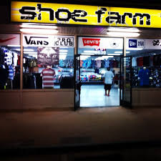
Job Shadow
Owner of Shoe Farm – Went along with my career path
Study business in college
I found the way he expanded his stores interesting
No memorable moment
See myself working in this field

Slide 5
Pathway
Computer Repair - Pursued it on accident
Business owner - teaches word, ppt, etc.
Taught me responsibility

Slide 6
Post High School Plans
Near Future
Fresno State - Accepted
Family & FAFSA/CAL Grant Support
Graduate with a bachelor's

Slide 7
Post High School Plans
Distant Future
Owner of:
Clothing Store
Barber Shop
Expand the companies to other towns and cities

Slide 8
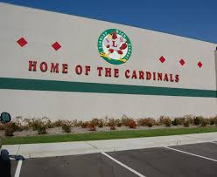
Leaving LHS
Clubs help out a lot
LHS has shaped me as an outgoing person & a good listener
PBS has taught me
Responsibility
Determination
Accepting failure

Slide 9
Thank You!
Questions?

